Slide 1
Smart Trash Bin
Author: Thawanrat Atthawiwatkul Student ID:62011277
Author: Tinchupeam Weerayutvilai Student ID:62011281

Slide 2
Topic
What is smart trash bin?
Hardware
Ultrasonic sensor HC_SR04
Schematic Diagram
Flowchart
Library
Code
Demo
Improvement & Conclusion

Slide 3
What is smart trash bin?

Slide 4


What is smart trash bin?
Our smart trash bin is a bin using IOT technology to measure inside of the trash bin and tell in percentage.

Slide 5
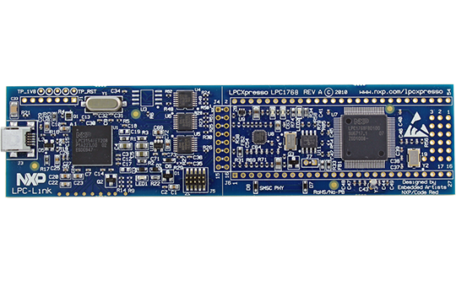
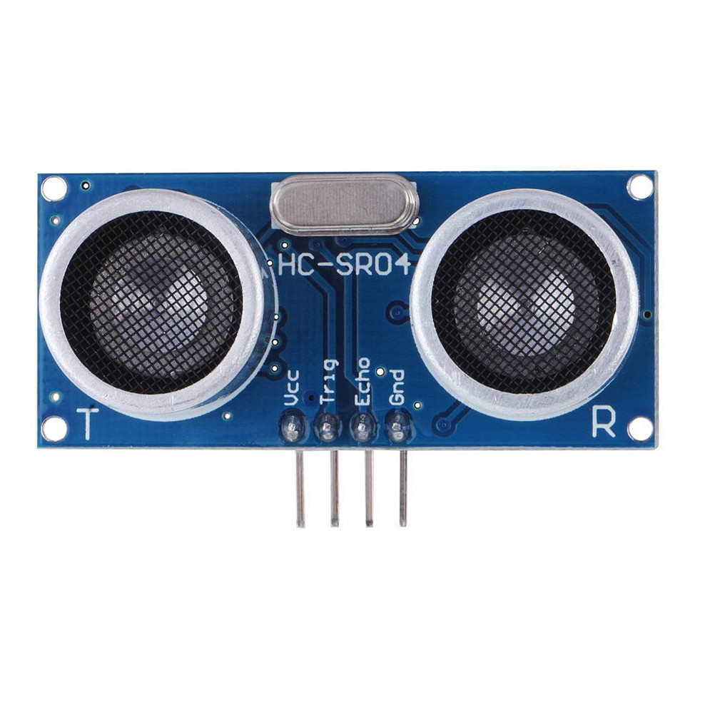
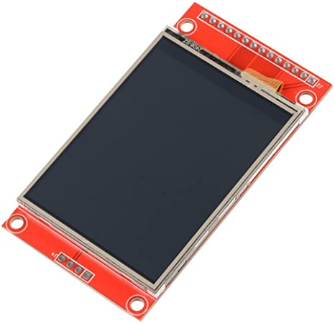
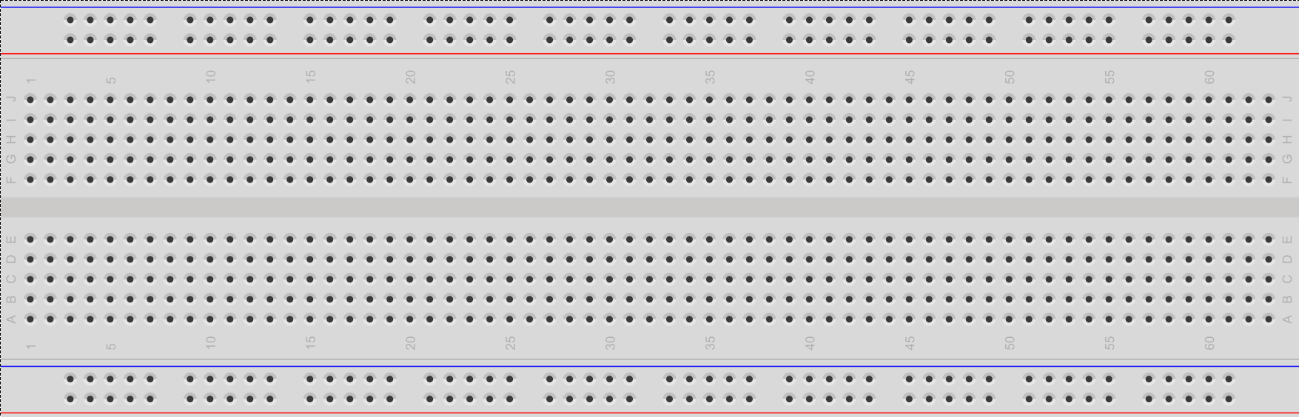
Hardware
LPCXPRESSO LPC1769
Ultrasonic sensor HC-SR04
LCD screen
Bread board

Slide 6
Ultrasonic Sensor HC-SR04
The HC-SR04 is one of the lowest cost Sonar-based distance sensor options available (as low as $3 US). There seem to be several hardware versions and/or clones that work the same as far the functions of the two pins (trigger and echo). It operates off of 5V DC power at around 15 ma (not active is 2 ma). The detection range is 3-400 cm with around a 15 degree beam width. Like most Sonars, it more readily detects large hard objects that reflect sound, so it might not see something soft like a fluffy cat. It uses a short 40 kHz ultrasonic ping that humans can't hear and then listens for the ping signal to return after reflecting off an object. The time delay for the reflected signal to echo back is used to measure the distance using a simple scaling calculation based on the speed of sound in air.
There are two transducers, one to transmit and one to receive. Two transducers turn out to be cheaper, since a higher voltage is needed to transmit and switching modes using only one transducer takes a lot of analog circuitry.
Small Sonar sensors are often used in robots to detect objects. Sometimes they are used along with an IR-based sensor to improve the likelihood of object detection. Some robots and other devices even add a mechanical bump or limit switch. To detect objects in different directions, some robots rotate sensors on a turret or use several sensors mounted facing out at different angles .

Slide 7
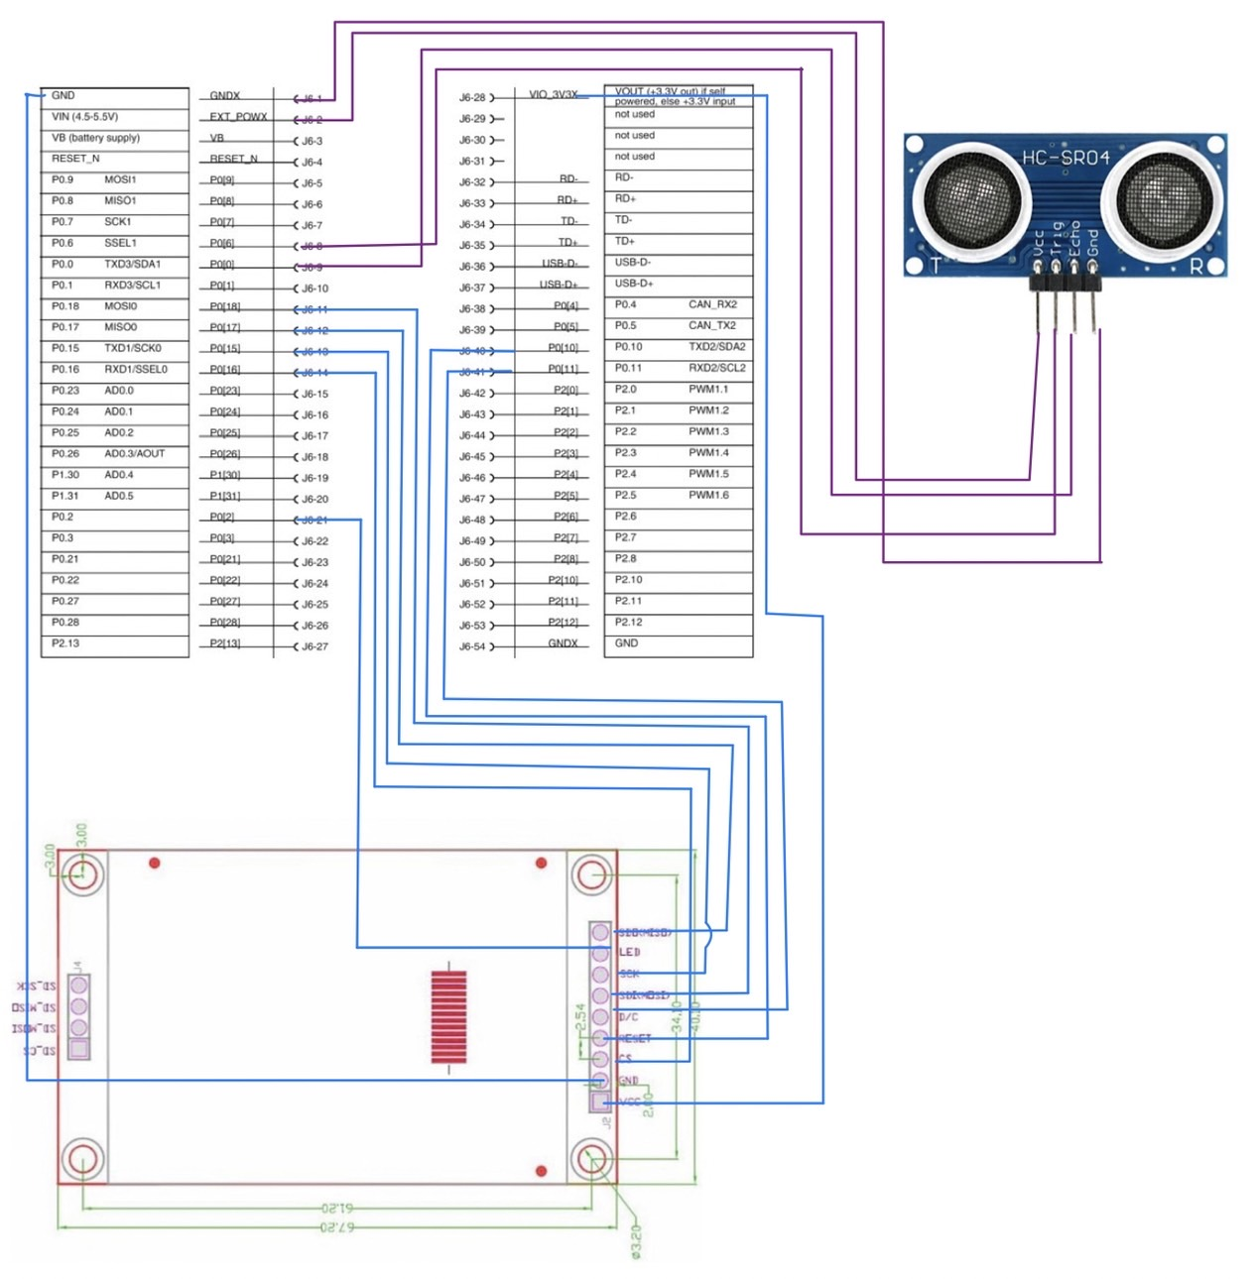
Schematic Diagram

Slide 8
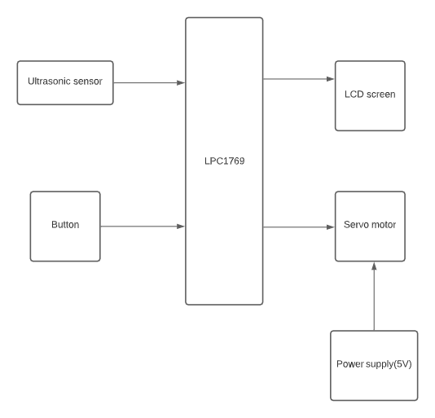
Block Diagram

Slide 9
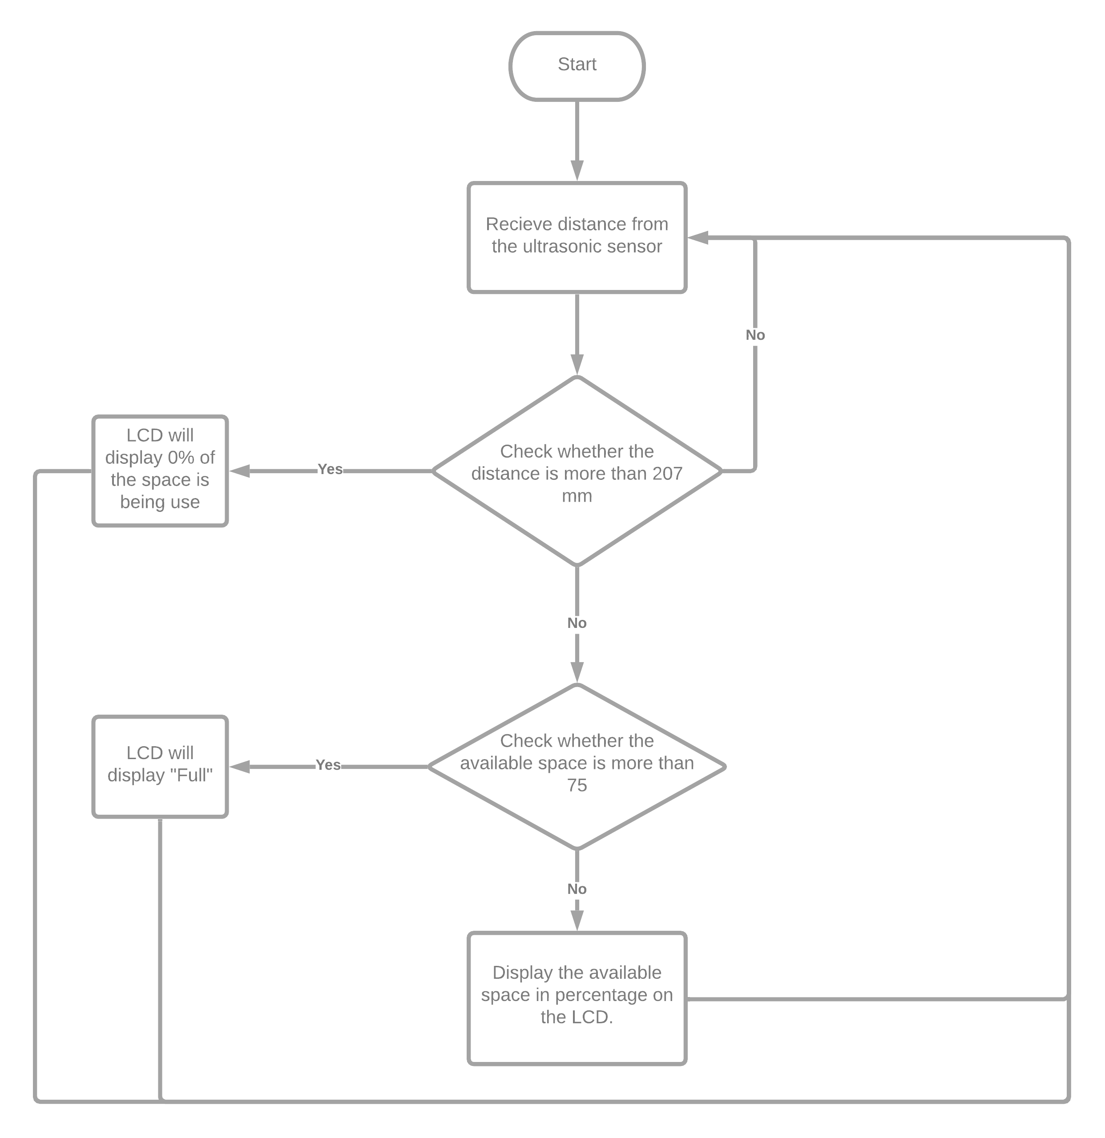
Flowchart

Slide 10
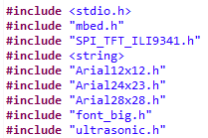
Library

Slide 11
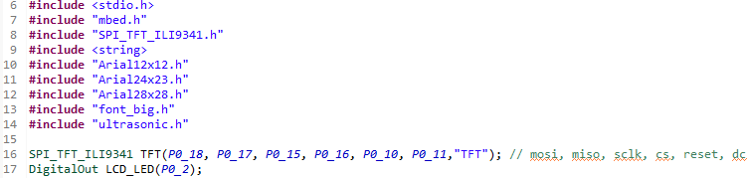
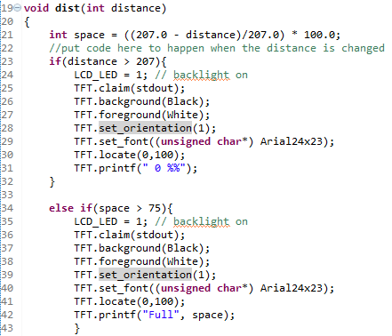
Code

Slide 12
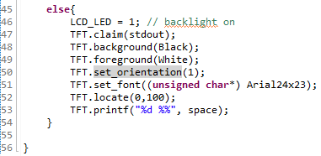
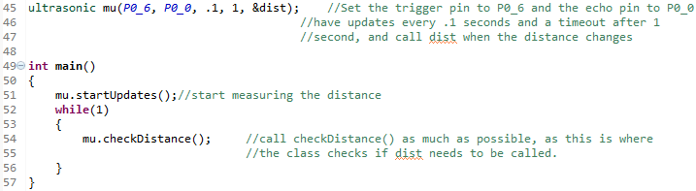
Code(2)

Slide 13

Demo Time
Smart Trash Bin

Slide 14

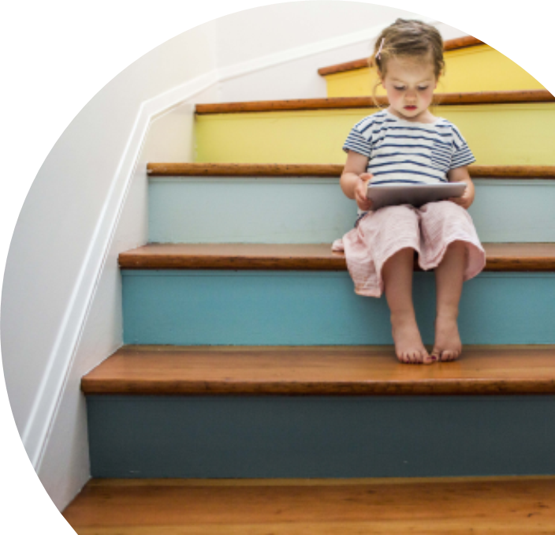
Improvement & Conclusion
We will make the bin door open automatically when the ultrasonic sensor can detect someone nearby using servo motor to power the servo leg to open the bin’s door.
The project uses the knowledge we have learnt from the lecture and lab. We also get to work in a team and create new useful things. We also experience many errors during work but eventually we find the right solution on time.

Slide 15
Thank you
Author: Thawanrat Atthawiwatkul Student ID:62011277
Author: Tinchupeam Weerayutvilai Student ID:62011281

